Slide 1
Catholic Charities
Service Learning Project
Brittany Brasiola, Erica Paulus, Taylor Powell

Slide 2

WellnessWorks
Goal: To promote healthier lifestyles among families requesting food and provide them with information they need to make healthy choices.
Unique Food Pantry
Health Screening
Monthly newsletter
Clients able to come once a month
Other helpful information

Slide 3
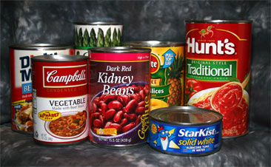
WellnessWorks Pantry
Foods for people with various health related diseases
  Low sugar/sugar free
  Low or no sodium
  Whole grain foods
  Gluten Free
  Low carb
  Canned fruits in light syrup
  Lean meats
  Tuna and chicken packed in water
  Nutrasweet or Splenda

Slide 4
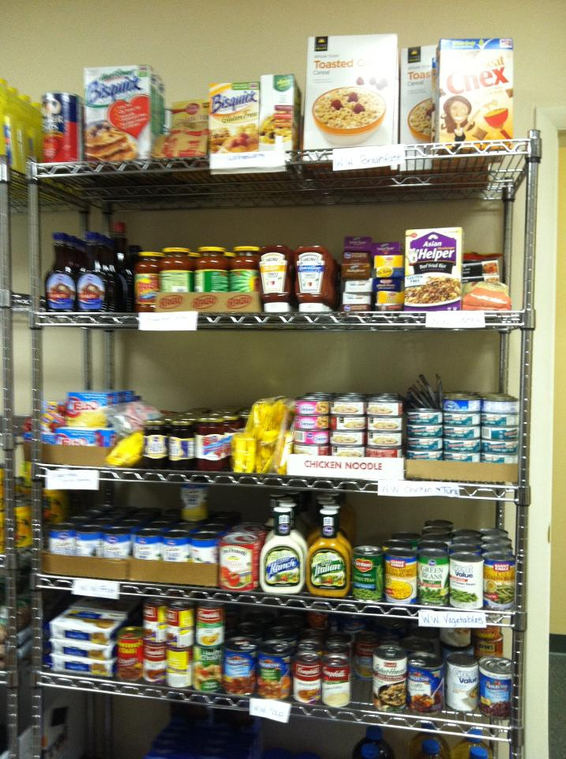
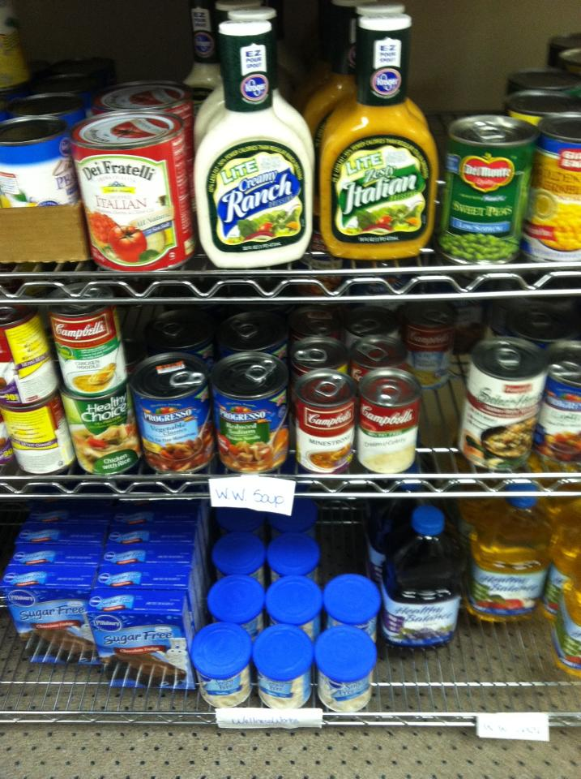
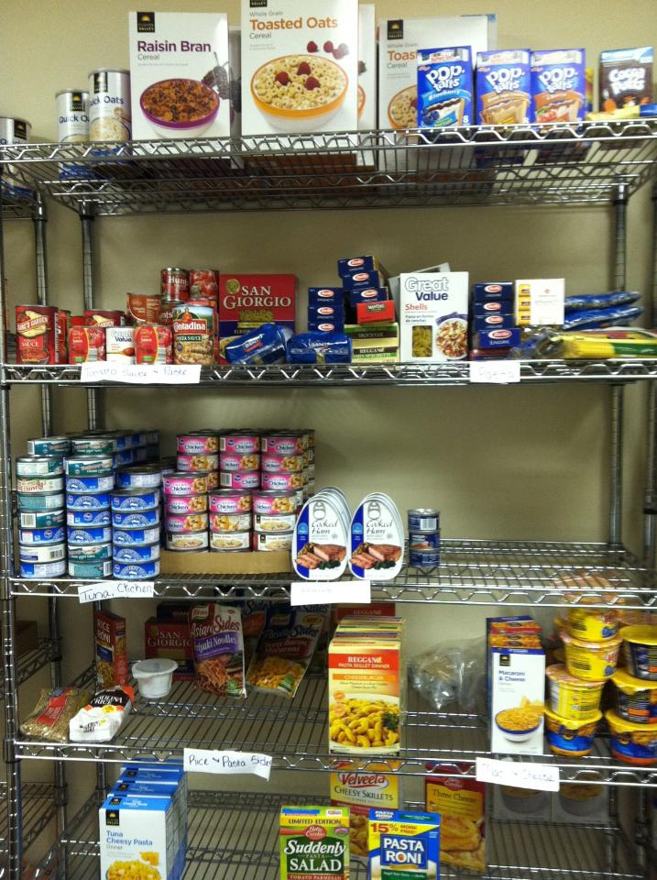

Slide 5
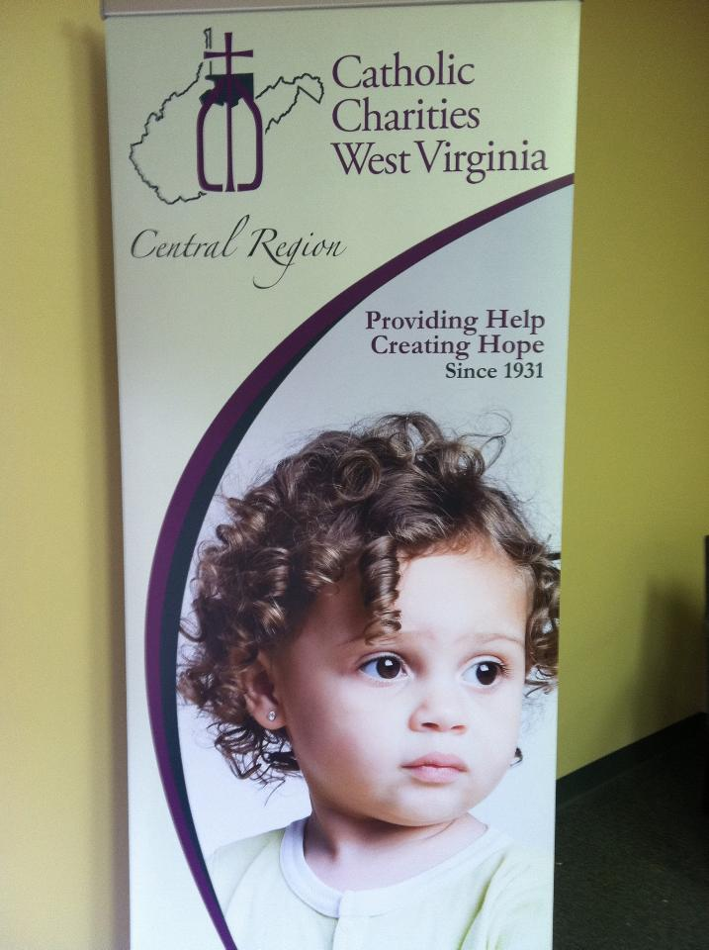
Our Goals and Objectives
Our Goal: To provide clients with further education about the food they could have to promote a healthier lifestyle.
Also, Educate the employees of Catholic Charities about nutrition.
We wanted to create simple
information that was easily
understood and helpful to both
the clients and employees.

Slide 6
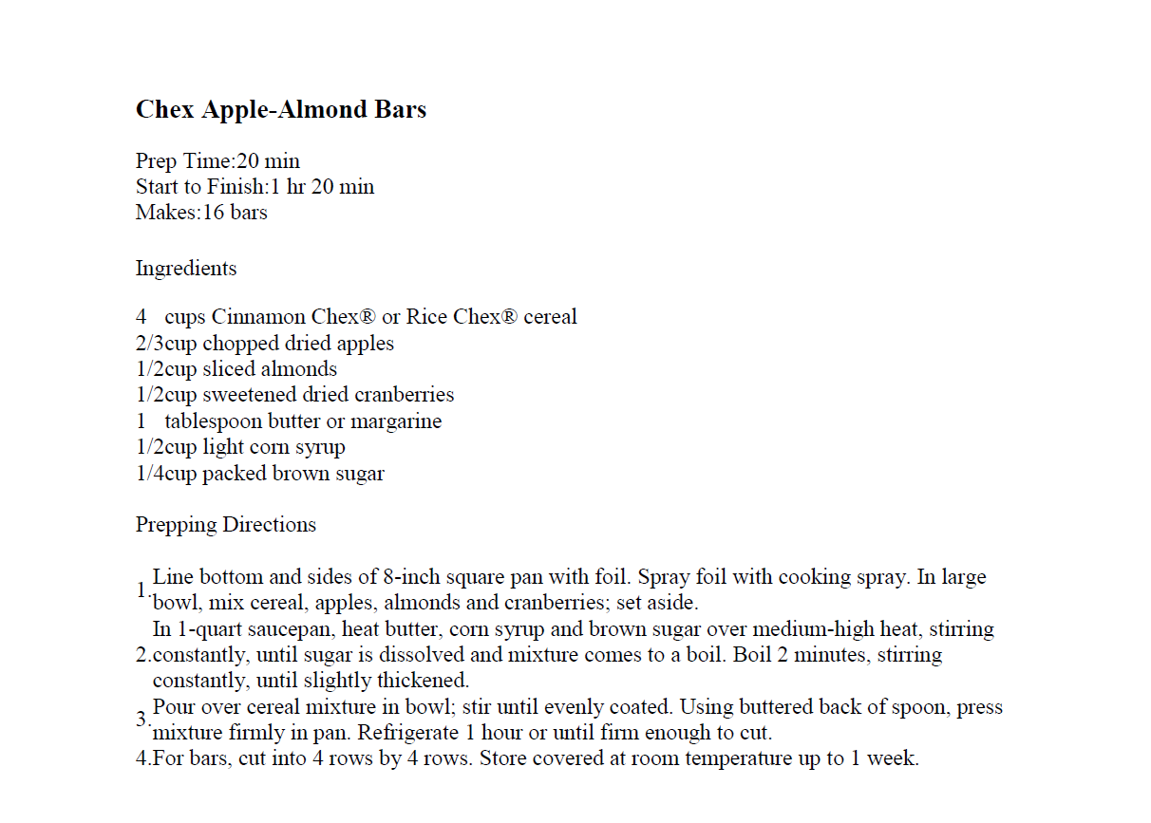
Implementation
Educational Tools:
  Diabetes
  High/Low Glycemic Foods
  Gluten Free
  Anemia
  Diverticulitis
  Gout
  Acid Reflux
  How to make foods
  healthier
Recipes

Slide 7
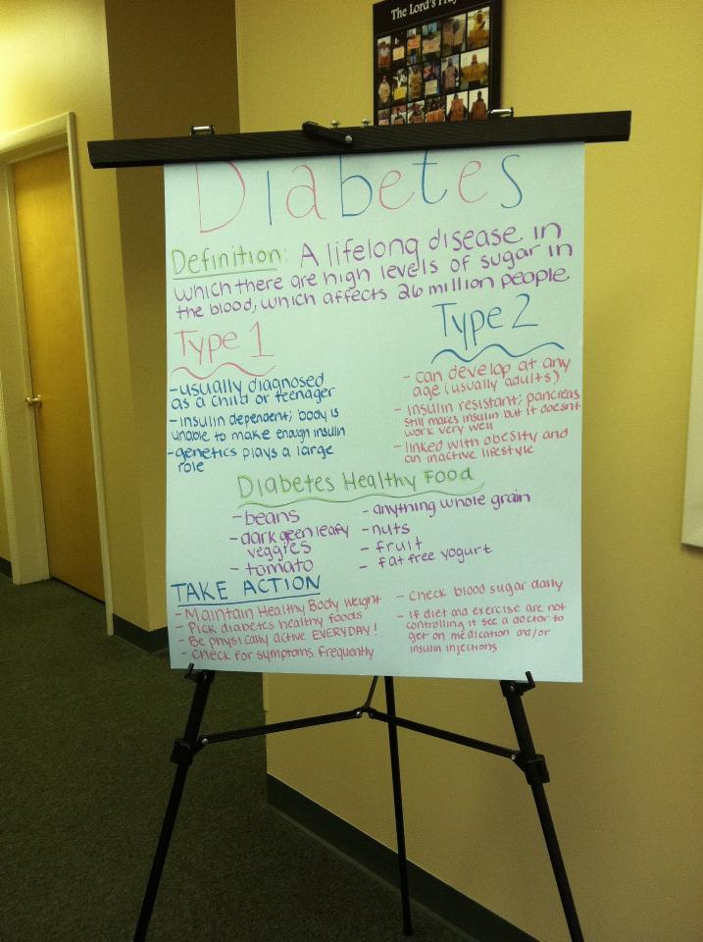
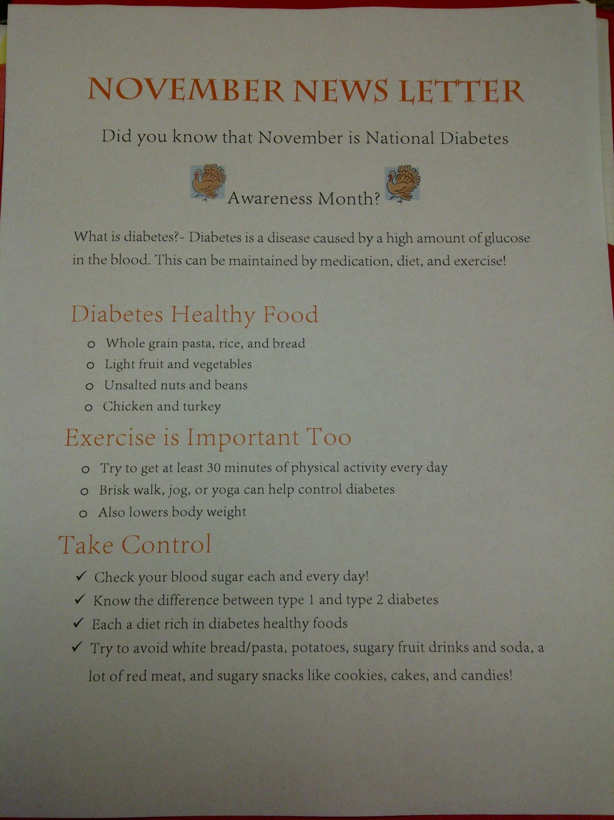

Slide 8
Evaluation
Sat in and participated in client health screenings and concluded with a short questionnaire asking questions about their nutrition.
Questions included:
  Do you know the types of foods that would be beneficial to you?
  Do you try to eat the foods that are beneficial to your health?
  Do you have any questions about your diet?
Most clients were aware of the foods that were beneficial to them and tried to stick to these foods when affordable. There were others, though, that were not willing to change their eating habits.

Slide 9
Possible Revisions
Informal survey for clients and employees of Catholic Charities to determine amount of knowledge gain.
Raise awareness for donations of healthy food from the public.
Create diet plans based on different calorie amounts.
Provide healthier fast food options.
Promote prevention

